Slide 1


SMART INDIA HACKATHON 2024
Bharat
Cruisers
Problem Statement ID - 1762
Problem Statement Title – Building a National Web Community of Philatelists "This is to overcome challenges faced by philatelists across India and to design a solution that enhances their experience and fills up gaps in access to information, raising demand and ensuring fulfillment as per interest for each Philatelic item and ancillaries released and made anywhere in the country through a web based community and a National Philately Deposit Account.
Theme - Transportation & Logistics
PS Category- Software
Team ID - 21900
Team Name - Bharat Cruisers

Slide 2
Bharat
Cruisers
Proposed Solution : The proposed website will serve as a centralized platform for the philatelic community across India. It will provide a variety of features, including :-
Innovation and Uniqueness of the Solution:
Interactive Virtual Exhibitions: Host online exhibitions where collectors can display and share their collections, fostering knowledge exchange and networking.
Crowdsourced Stamp Designs: Allow users to submit stamp designs, engaging the community in the creative process.
Philatelic Forums: Provide discussion boards for collectors to discuss new releases, share tips, and connect with fellow philatelists.
Nationwide Philatelic Access: The platform will display philatelic items from all postal circles in India, allowing philatelists to view and order from any region.
National Philately Deposit Account: Philatelists can create accounts to manage collections, track orders, and stay updated on new releases.
Online Ordering and Payment: Users can easily order and pay for items through the website with integrated payment options.
Postal Services Integration: The site will use standard Registered/Speedpost services for reliable delivery and tracking.
Cancellation Releases: A section will provide info on cancellation releases, allowing users to order and pay for them conveniently.
Digitization of Rare Collections: Partner with collectors to digitize rare stamps, making them accessible online for study and appreciation.
Loyalty Programs: Offer points for purchases, discussions, and referrals, redeemable for discounts and exclusive perks.

Slide 3







Bharat
Cruisers
TECHNOLOGY STACK
TECH FLOW
Technologies and its Implementations :
Frontend: HTML, Sass & Tailwind (advance CSS ), JavaScript, React.
Backend:
Node.js : For run time environment and as Express server .
Express : For building APIs , handling routs .
Database:
MongoDB : For storing various data such as user information.
Other tools
Redux : For state management such as session data, card items.
Socket.io : Real time notification and stamp availability .
Multer : For files handling ( stamp image upload ).
APIs
Razorpay : For payment purpose .
Twilio : For SMS notification for various task .
Speed post : For placing orders .

Slide 4
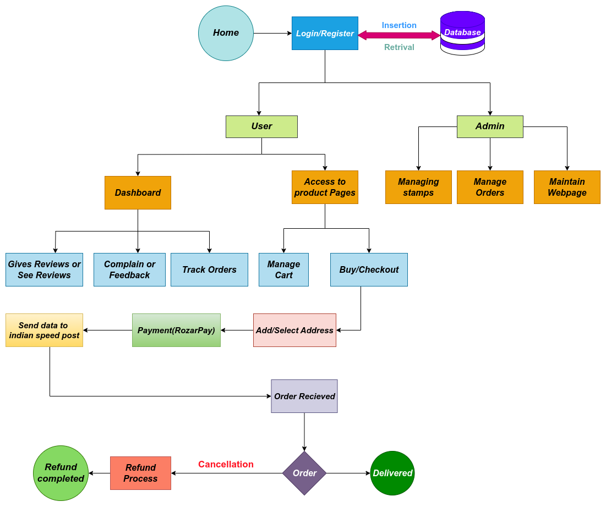

Bharat
Cruisers
WORK FLOW

Slide 5
Bharat
Cruisers
FEASIBILITY AND VIABILITY
Feasibility Analysis:
Technical Feasibility
Modern technologies such as HTML5, React js , Sass are used for responsive and light weight design.
Node.js, Express for serving web pages and load management.
APIs such as Razorpay and speed post are used for secure payment and delivery .
Operational Feasibility
User Base: Serves a niche but dedicated philatelist community.
Resources: Requires a development team and ongoing content updates.
Legal Feasibility
Compliance: Data protection and postal service approval needed.
Market Feasibility
Demand: Strong need for centralized philatelic access.
Strategies for Overcoming Challenges:
Data Accuracy: Collecting reliable philatelic info nationwide may be difficult, risking user trust.
Security: Protecting users from fraud and ensuring secure transactions is crucial.
Fulfillment Issues: Delays in item delivery could frustrate users.
Scalability: The platform must handle large user volumes efficiently.
Strategies for Overcoming Challenges:
Data Accuracy: Partner with postal services and collectors to source reliable philatelic data.
Security: Implement strong encryption, user verification, and fraud detection systems.
Fulfillment: Build partnerships with logistics providers for timely deliveries.
Scalability: Use cloud infrastructure (aws) to handle increasing traffic efficiently.

Slide 6
Bharat
Cruisers
IMPACT AND BENEFITS
Impacts:
Greater Access: Philatelic items can be acquired by collectors from any location in India, hence promoting inclusion.
Simplified Search: Finding and staying up to speed on new releases is made simple by the centralised platform.
User Convenience: Easy online payment and ordering processes increase user happiness.
Community Engagement: Promotes a lively, engaged community where people can exchange collections and expertise.
Sales Growth: In the philatelic sector, sales are driven by rising demand and awareness.
Historical Preservation: Digital collections guarantee the durability and availability of uncommon stamps.
Sustainable Revenue: The platform's revenue stream is dependable due to commissions and subscription fees.
Benefits:
1. Enhanced Accessibility: Regional barriers are eliminated as philatelists can now access items from all postal circles.
2. Centralized Information: It's simpler to stay updated because all philatelic releases are accessible on a single site.
3. Convenience: Purchasing goods is made quicker and more effective with simplified ordering and payment processes.
4. Stronger Community: Knowledge sharing within a connected philatelic community is facilitated by interactive elements.
5. Heritage Preservation: Rare collections are preserved through digital archives for upcoming research and appreciation.
6. Higher Engagement: Over time, community features and loyalty schemes maintain users' engagement.

Slide 7
Bharat
Cruisers
RESEARCH & REFERENCES

